Slide 1

Hotel Booking Analysis Report
Comprehensive analysis of 118,897 hotel bookings revealing key insights into cancellation patterns, pricing dynamics, and customer behavior across city and resort hotels.

Slide 2
Research Questions & Hypothesis
Key Questions
Our Hypotheses
What variables affect hotel reservation cancellations?
Higher prices drive more cancellations
Longer waiting lists increase cancellation frequency
How can we reduce cancellation rates?
How can hotels optimize pricing and promotions?
Most clients book through offline travel agents

Slide 3
Dataset Overview
Dataset Specifications
37.1%
$102
File: cleaned_data.csv
Total Rows: 118,897 bookings
Cancellation Rate
Average ADR
Total Columns: 31 variables
Overall booking cancellations
Average daily rate per booking
Missing Values: 0 (fully cleaned dataset)
The dataset includes comprehensive booking information spanning hotel type, guest demographics, booking channels, pricing, and reservation status.
104
Lead Time
Average days before arrival

Slide 4

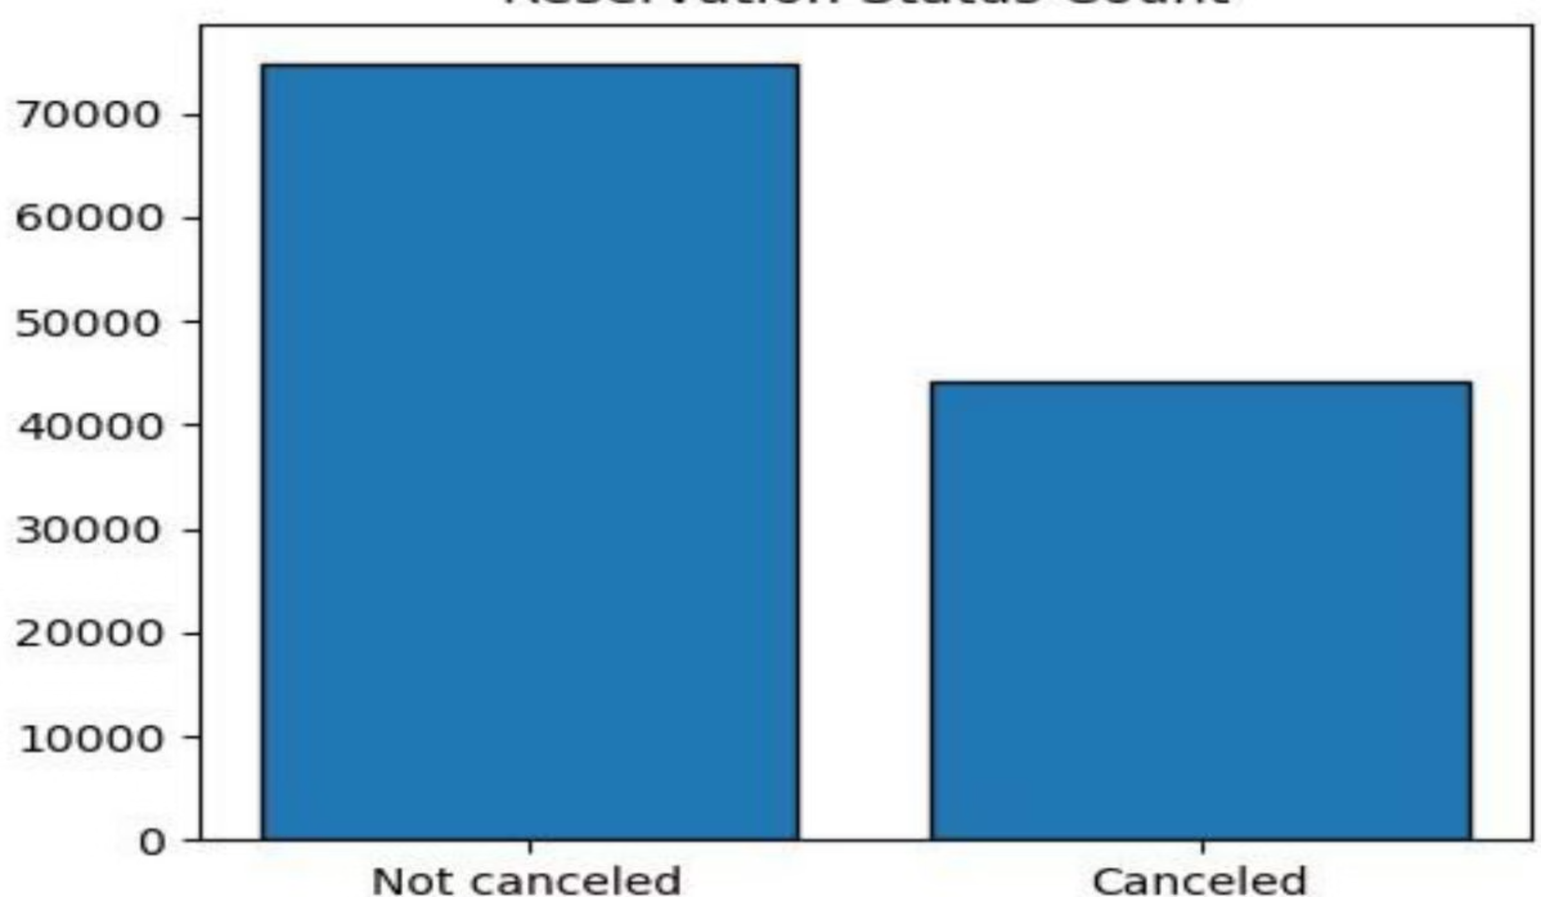
Cancellation Impact
The bar graph reveals that while 63% of reservations remain confirmed, 37% of clients cancel their bookings, significantly impacting hotel revenue streams. This substantial cancellation rate represents a critical challenge for hotel profitability and operational planning.

Slide 5
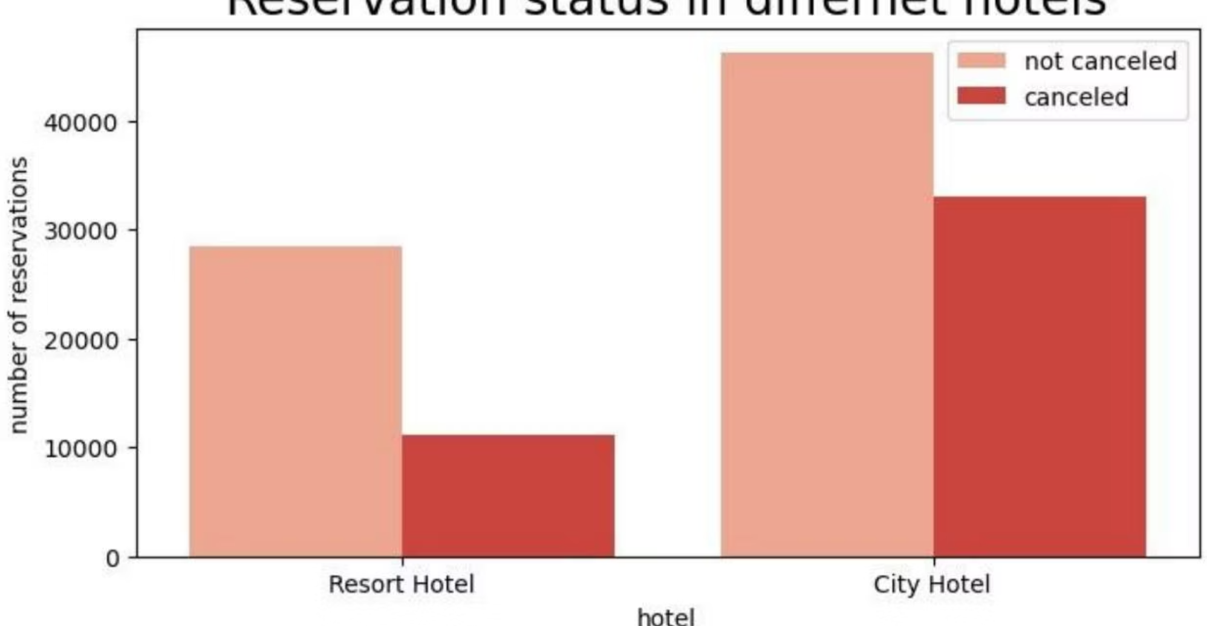
City vs. Resort Hotels
Key Insight
City hotels receive significantly more bookings than resort hotels, likely due to lower price points and business travel demand.
Resort hotels show higher cancellation ratios, suggesting price sensitivity among leisure travelers.

Slide 6


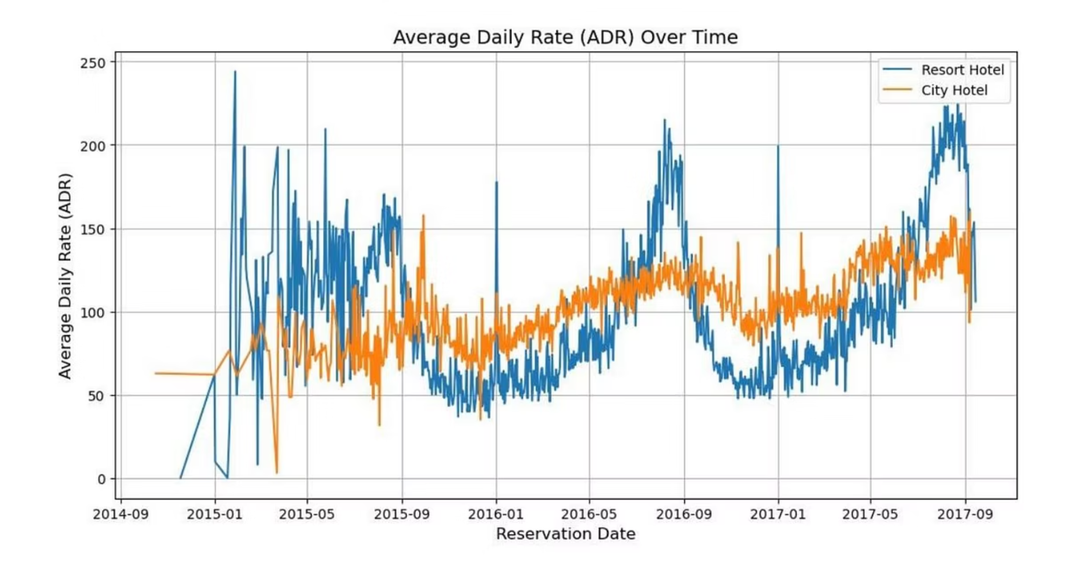


Pricing Dynamics
Weekday Rates
City hotels often have lower ADR than resort hotels on regular days
Weekend Premium
Resort hotel rates surge during weekends and holidays
Price Sensitivity
Higher rates directly correlate with increased cancellations

Slide 7

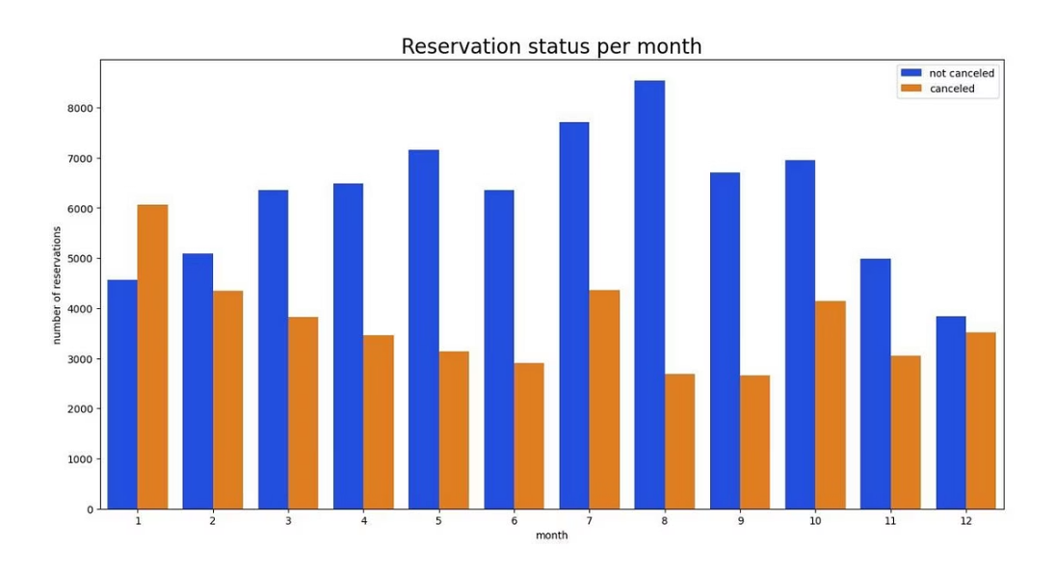
Seasonal Booking Patterns
Peak Season
Critical Period
August shows the highest volume for both confirmed and canceled reservations, representing peak travel demand.
January experiences the highest cancellation rate, presenting an opportunity for targeted marketing campaigns.
Other high-booking months: July, May, October, April

Slide 8

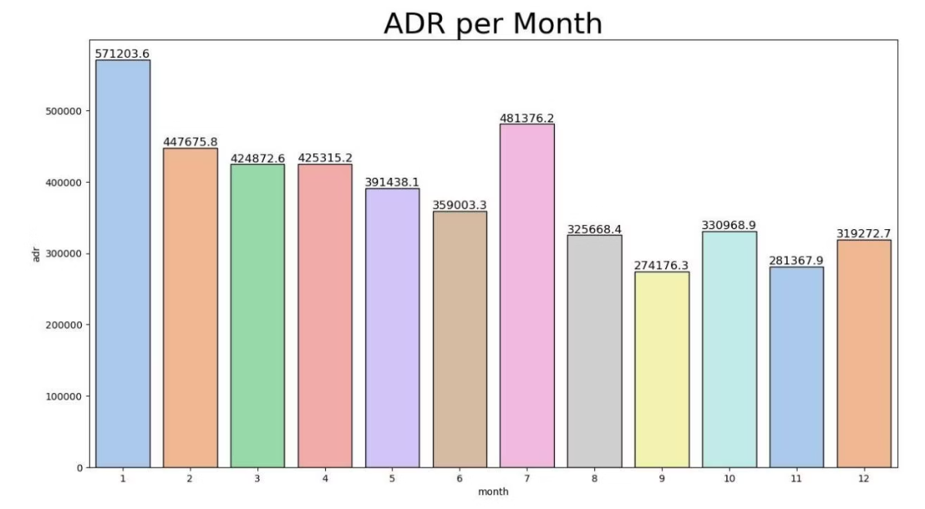
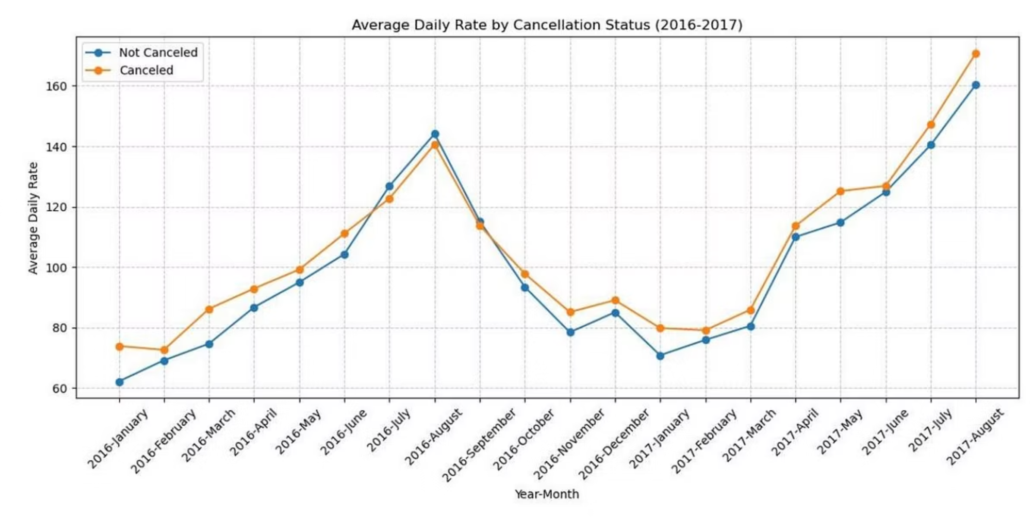
Price-Cancellation Correlation
The Price Factor
Analysis confirms that cancellations peak when prices are highest and decline when rates are lower.
The accommodation cost is the primary driver of cancellation decisions.

Slide 9
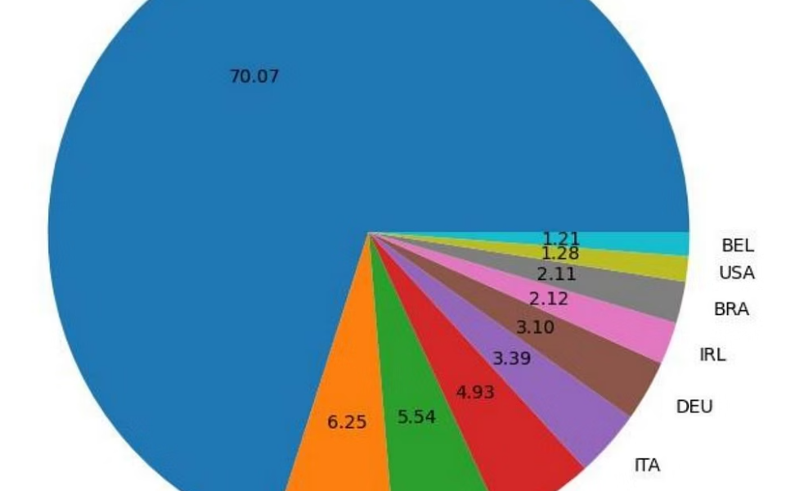
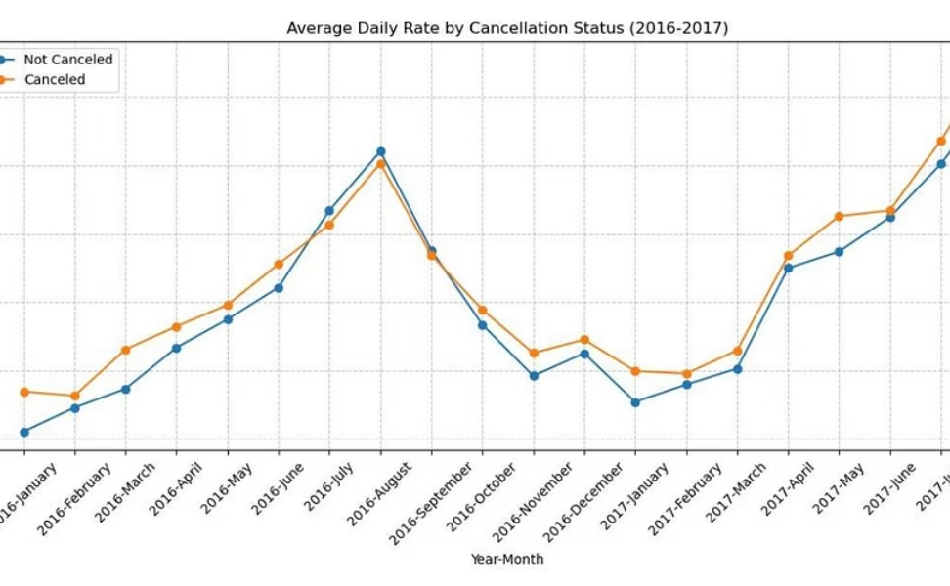
Geographic & Channel Insights
Top Markets
Booking Channels
Portugal leads with 48,585 bookings but also highest cancellations. UK (12,129), France (10,415), Spain (8,568), and Germany (7,287) follow.
46% book via online travel agencies, 27% through groups. Only 4% book directly, contradicting the hypothesis about offline agents.

Slide 10

Strategic Recommendations
01
Dynamic Pricing Strategy
Implement location-based pricing adjustments and offer strategic discounts to reduce cancellations when rates are high.
02
Weekend & Holiday Promotions
Provide reasonable discounts for resort hotels during weekends and holidays to balance the higher cancellation ratio.
03
January Campaign Focus
Launch targeted marketing campaigns in January with competitive pricing to convert the high cancellation period into revenue opportunity.
04
Portugal Market Enhancement
Improve hotel quality and services in Portugal to address the highest cancellation rates in this key market.

